Slide 1
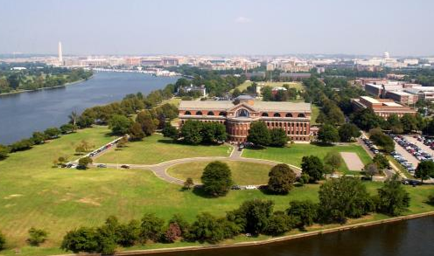
Security Overview for Faculty and Staff
Mr. Nick Kutchak
Director of Security

Slide 2
Full-Service Security Office
Security Manager
Special Security Office (SSO)
Physical Security (Badging)
Information Security
Personnel Security (Investigations, PRs, etc)
OCONUS Travel briefings & Foreign contract reporting
RAPIDS (CAC) Issuance and PIN reset
Secure (SCI/Secret) VTC scheduling – Trusted Agent
Personal Status Changes (Marital, Finance & Civil)
PRESENTERS NAME
DATE

Slide 3
NDU Security Staff
Director of Security - Mr. Nick Kutchak
Deputy Director - Mrs. Deborah Scavone (South)
Physical Security Officer/COMSEC Specialist - Mr. “Scott” Head (North)
- Ms. Sharon Ogletree (South)
Physical Security Specialist - Mr. Alex Liebeno
Information Security Specialist/OPSEC - Mr. Jimmy Sanford
Personnel Security Specialist/Badging - Ms. Montez Winters
- Ms. Tamika James
Locksmith - Mr. Robert Gibbs
CAC Administrator - Mr. Carl Wright

Slide 4
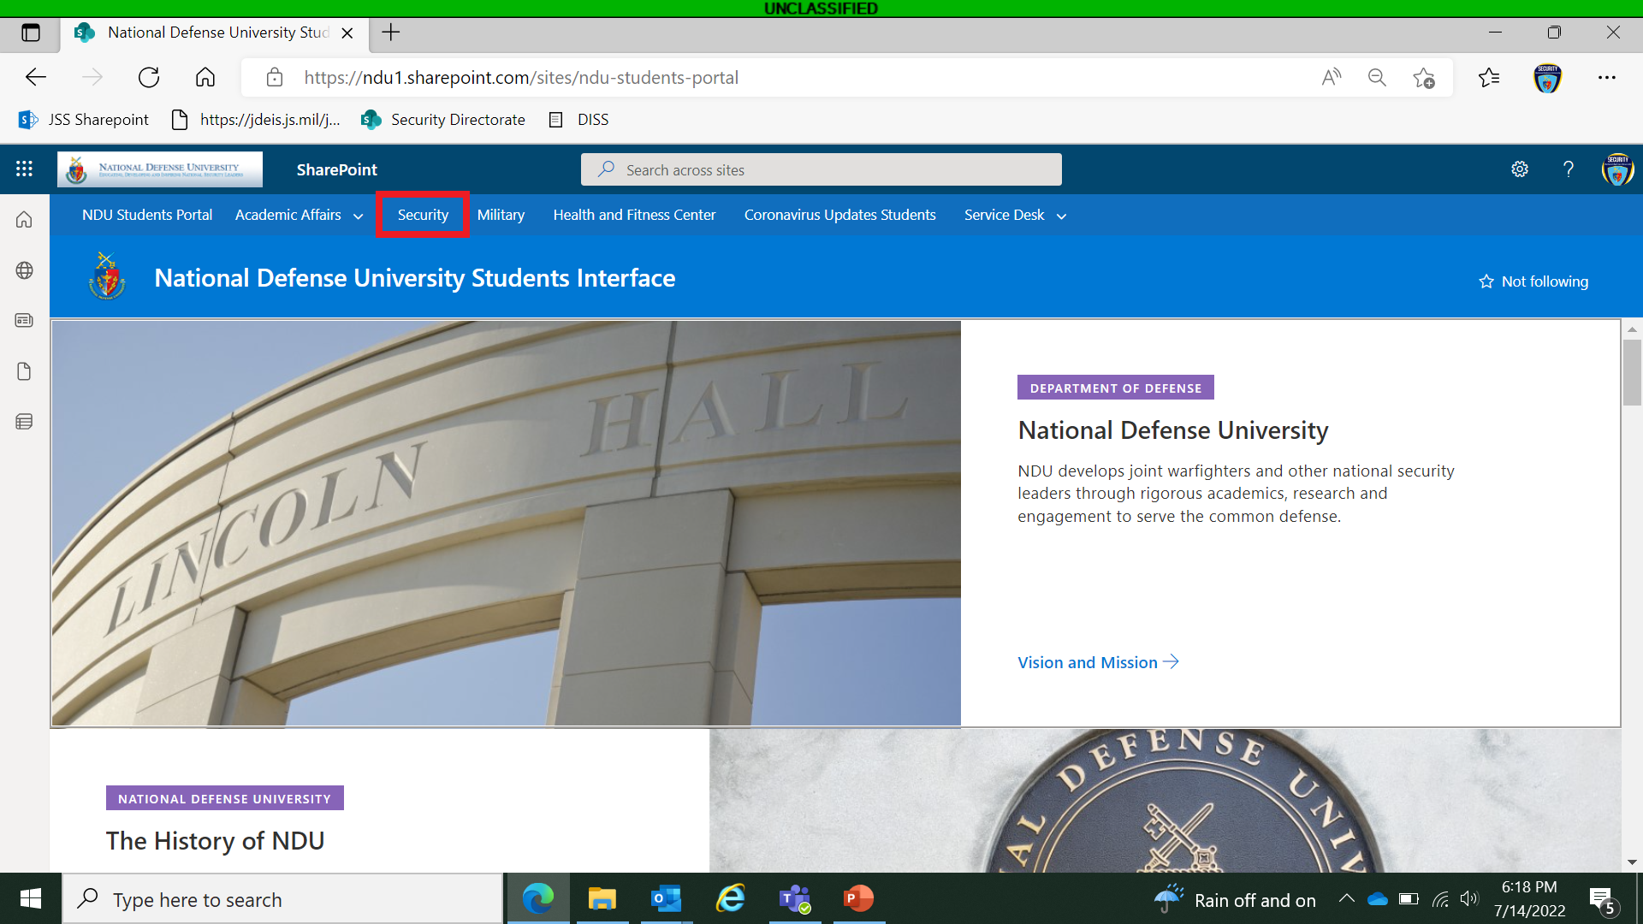
SharePoint- Your Knowledge Resource

Slide 5
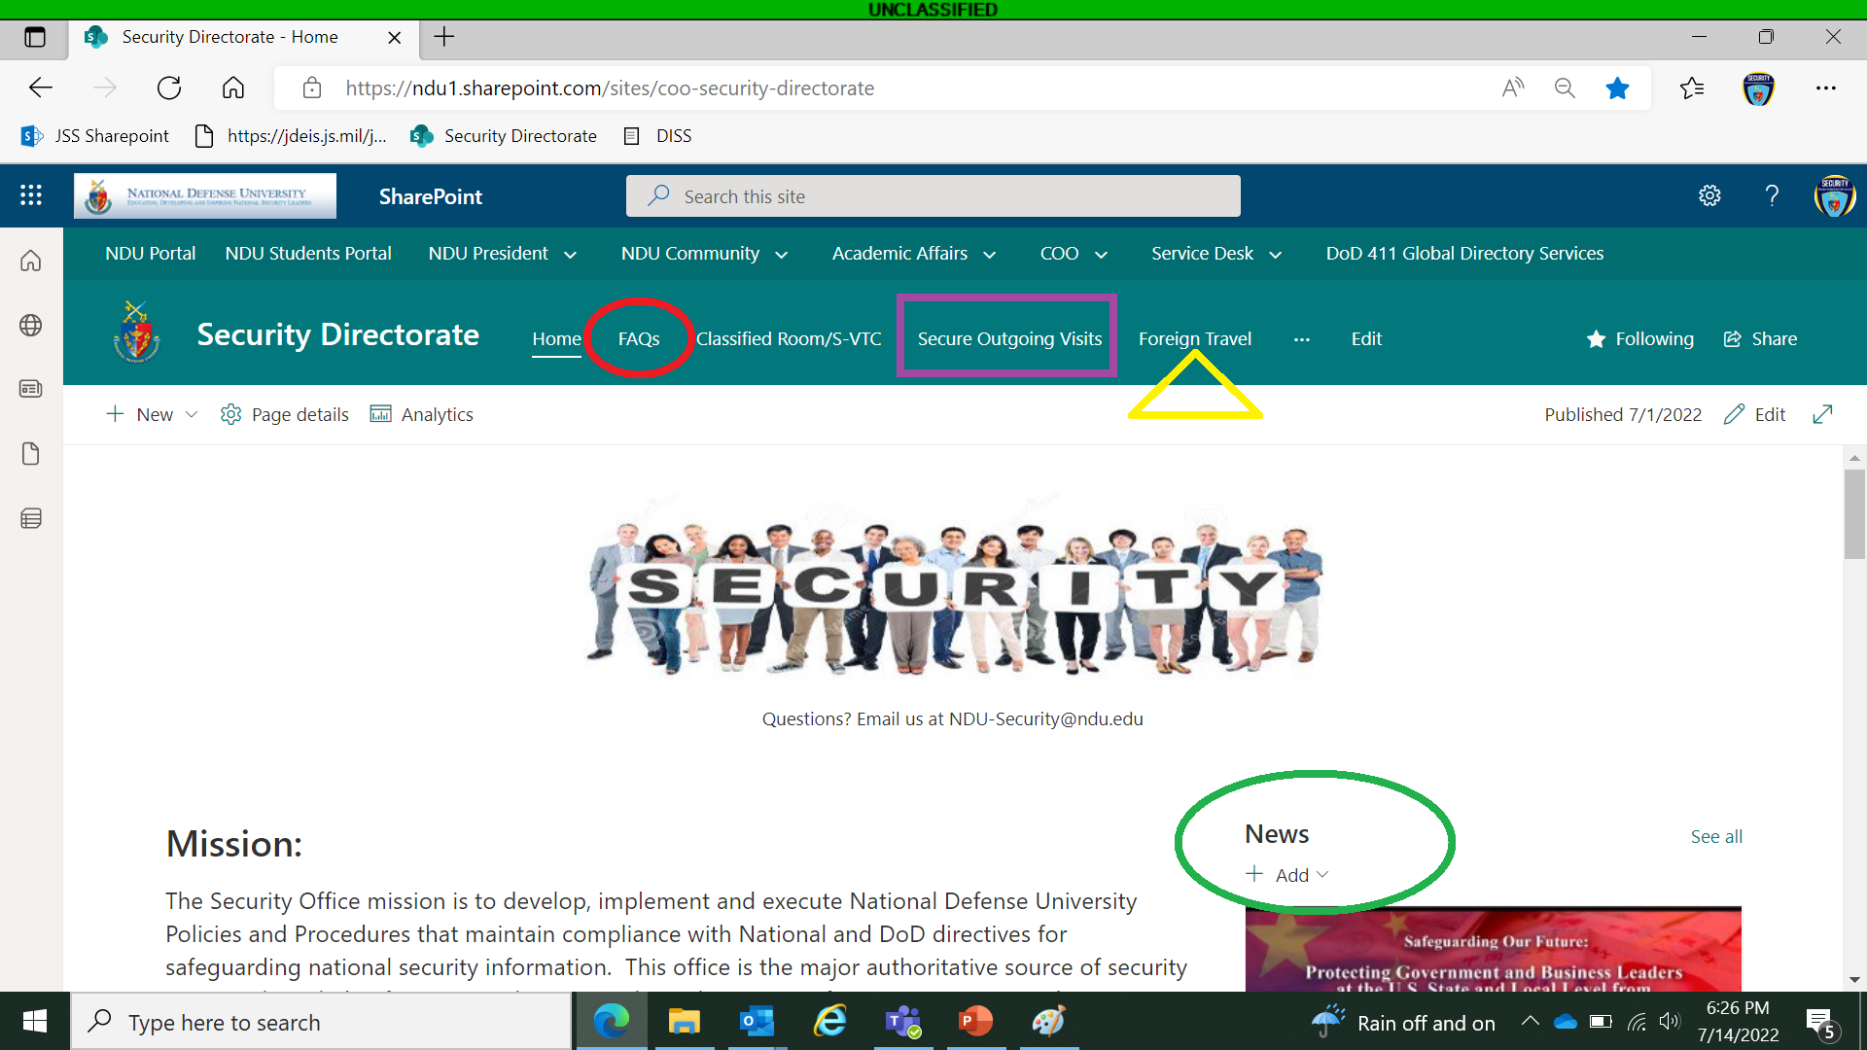
SharePoint- Your Knowledge Resource

Slide 6
Installation Access
100% ID Check:
Valid active duty/retired ID or CAC.
DOD Civilian CAC (Staff, Faculty and Students)
Fort McNair: SUSPENSION OF TRUSTED TRAVELER PROGRAM
Visitors, valid State issued Drivers License. Will need to be vetted at bldg. 65, outside 2nd street gate prior to entrance. Or by filling out a pre-screen at https://pass.aie.army.mil/jbmhh/
NDU Building Badges are NOT Recognized at the Gates
PRESENTERS NAME
DATE

Slide 7
Fort McNair Gates
Ceremonial Gate Closed permanently due to enhanced FPCON measures
Exit only from 1500-1800 M-F
2nd Street Gate Open 24/7 (Only gate open for vehicle traffic)
This gate has a search lane for non-DOD ID card holders
All visitors must be vetted prior to entry

Slide 8
Pedestrian Turnstile Gate
Gate authorized for entry 24/7 with CAC/USID (Veteran/Retire)
Location: Adjacent to the Main Gate (Ceremonial)
Contact NDU Physical Security to be added to pedestrian gate access roster
Registration controlled by JBM-HH Physical Security Personnel
Mon-Fri: 0800 to 1600 (walk-in basis only)
Requires CAC registration and PIN; Gate has card reader
Authorized for valid users who walk from the Metro or local vicinity
Egress via the turnstile gate does not require a CAC; anyone can use it

Slide 9
Installation Information
3 Strike Driving Policy
Garrison CDRs policy; if issued 3 citations within 12 month period, your driving privileges will be suspended
Speed Limits are strictly enforced
Speeding citations are CVB tickets subject to DC Federal Court
Use of a Cell phone while driving is prohibited, except with Hands Free Device
Running/Bicycling on Post – No head phones and must have reflective equipment
PRESENTERS NAME
DATE

Slide 10
NDU Building Badges
NDU badges are for building access only!
You must Badge In and Out of the Buildings AWAY (even if for lunch)
Badges must be worn at all time above the waist
Access to certain rooms will be granted on a case-by-case basis
OPSEC: Remove badges once outside NDU
PRESENTERS NAME
DATE

Slide 11
Force Protection – Emergency Notification
Force Protection Conditions (Alpha thru Delta)
Currently in FPCON B
Emergencies
Notifications via Bldg. internal intercom, Mass Notification service (Blackboard Connect), e-mail and JBM-HH “Big Voice” speakers for outside parade field alerts
Safety
McNair is a safe install
Outside the “wall” incidents often seasonal (Fall – early Spring)
Be aware of your surroundings
Use the buddy system or stay close to a group
PRESENTERS NAME
DATE

Slide 12
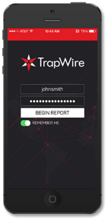
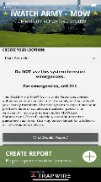
iWatchArmyMD
Your Observation and Your Report
Could Help PREVENT a Terrorist Attack, Active Shooter, or Criminal Attack
Against Our Community
If You See or Hear Something Suspicious or Not Normal for Your Environment, Take a Photo of the Person/Vehicle/Item and Report Immediately
iWatchArmyMDW.org
Download the new
iWatchArmyMDW
Mobile App
Examples of What You Should Report
UAS/UAV/Drone over or near our facilities
Physical security item damaged or breached
Expressed or implied threat (in-person, e-mail or social media)
Person asking about security or if you have a security clearance
Person with multiple or fake CAC/DoD cards or driver’s licenses
Person appears to be surveilling or casing our personnel or facilities
Person watching or timing building evacuation or lock-down exercise
Person in or attempting to enter restricted area without proper access
Do NOT Report Emergencies or Quality of Life Complaints via iWatchArmyMDW

Slide 13
Questions?
Welcome to NDU
You are in a Great Place.
Our customers are the most important people of the day.
Office Hours: 0800-1130, 1230-1500 M-W
0800-1200 F
24/7 @ NDU-Security@ndu.edu
If you have any questions or need anything, please feel free to ask any staff member.
PRESENTERS NAME
DATE

